Slide 1
Data Presentation
Marketing Analytics Portfolio Project
Shaikh Adeeba

Slide 2
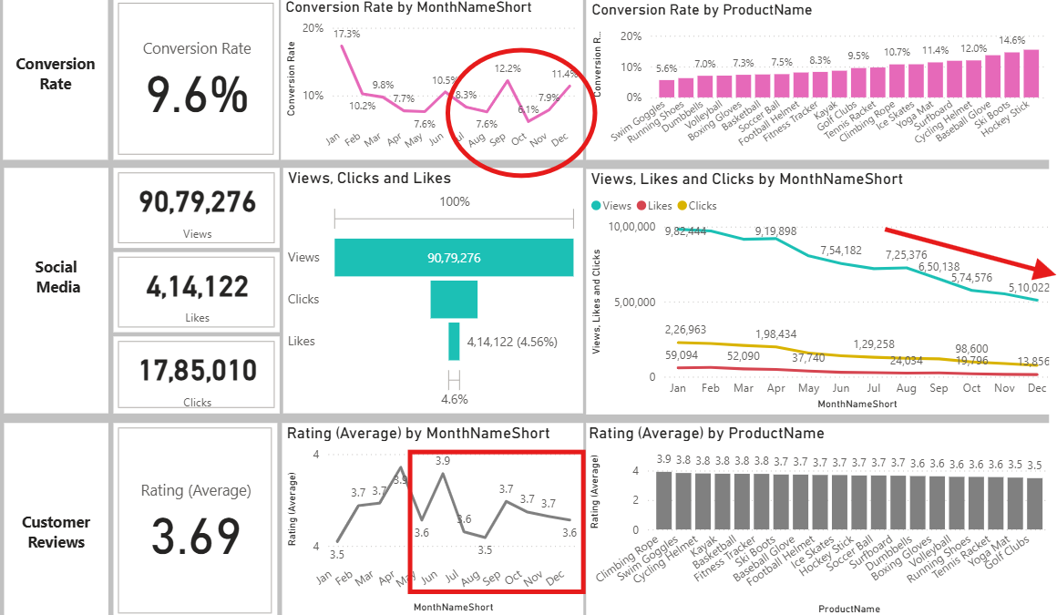
Overview
Decreased Conversion Rate:
Despite a notable dip in October and November, the conversion rate rebounded strongly in December, reaching 11.4%. October and November showed rates of 6.1% and 7.9%, respectively.
Reduced Customer Engagement:
Overall social media engagement has declined, with views decreasing throughout the year.
Although clicks and likes are low compared to views, the click-through rate stands at 19.66%, indicating that engaged users are still interacting effectively.
Customer Feedback Analysis:
Customer ratings have remained consistent, averaging around 3.69 throughout the year.
Although these ratings are stable, they fall behind the target of 4.0, indicating a need to focus on customer satisfaction for products rated below 3.5.

Slide 3
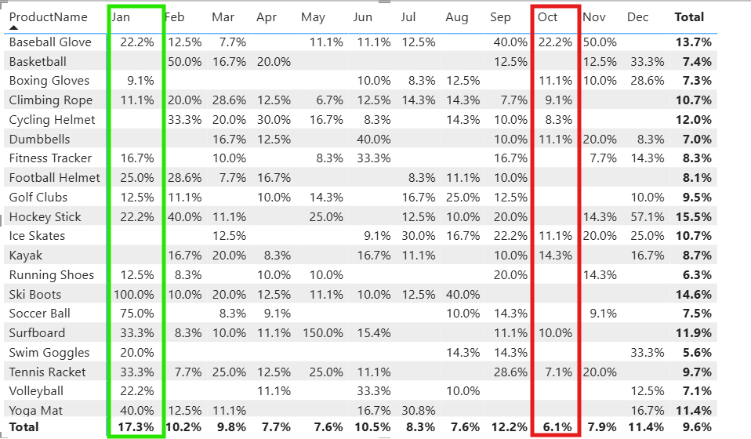
Decreased Conversion Rate
General Conversion trend:
Throughout the year, Conversion rates varied, with a higher number of products converting in February, March, June, July, and December. This suggests that some products follow seasonal peaks, and there is a potential to improve in low-performing months through targeted interventions.
Lowest Conversion Month:
May experienced the overall lowest conversion rate of 6.1%, with bare minimum products standing out significantly. This indicates to revisit the marketing strategies or promotions to boost the performance during this period.
Highest Conversion Month:
January recorded the overall highest conversion rate at 17.3%, with Ski Boots contributing a full 100% conversion.This reflects a strong start to the year, likely driven by seasonal demand and effective marketing strategies.

Slide 4
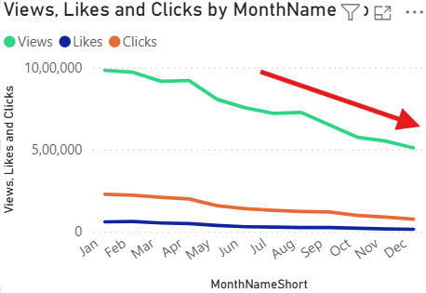
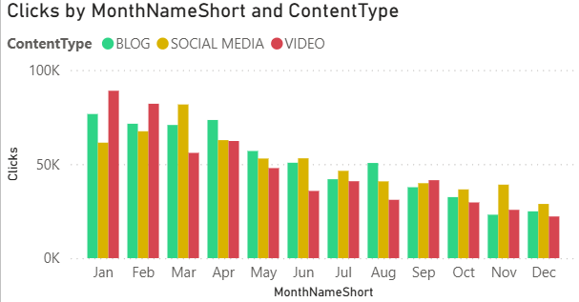
Reduced Customer Engagement
Declining Views:
Views peaked in February and July but declined from August and so on. This indicates the reduced customer engagement in the latter half of the year.
Low Interaction Rates:
Likes and clicks remained consistent by comparatively low to Views. This info suggests that there is a need for more engaging content and a stronger call to action.
Content type performance:
Blog Type drove the most views in January, February, March, and April. While Social media and Video content remained steady, but slightly lower engagement.

Slide 5
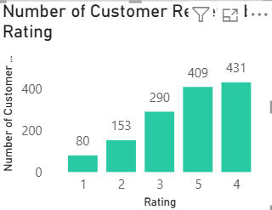
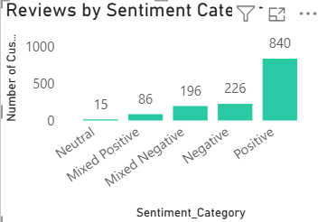
Customer Feedback Analysis
Customer ratings distribution:
Majority of customer reviews fall under higher ratings, with 431 reviews at 4 stars and 409 reviews at 5 stars. Lower ratings(1-2) stars account for a smaller proportion, with 80 reviews at 1 star and 153 at 2 stars.
Sentiment Analysis:
Positive sentiment dominates with 840 reviews, reflecting a generally satisfied customer base; 226 reviews are negative, and there is a smaller portion with neutral and mixed sentiments. Suggesting some areas for improvement, but overall, strong customer approval.
Opportunity for improvement:
Presence of mixed positive and mixed negative sentiments suggests an opportunity to convert those mixed reviews more clearly into positive ones, boosting overall ratings. Addressing those specific concerns in mixed reviews could elevate customer satisfaction.

Slide 6
Goals and Actions
Goals
Increase Conversion Rates:
Goal: Identify factors impacting the conversion rate and provide recommendations to improve it.
Insight: Highlight key stages where visitors drop off and suggest improvements to optimize the conversion funnel.
Enhance Customer Engagement:
Goal: Determine which types of content drive the highest engagement.
Insight: Analyze interaction levels with different types of marketing content to inform better content strategies.
Improve Customer Feedback scores:
Goal: Determine which types of content drive the highest engagement.
Insight: Analyze interaction levels with different types of marketing content to inform better content strategies.
Actions
Increase Conversion Rates:
Target high-performing product categories – Focus on improving higher conversion rate products such as Baseball Glove, Skii boots, Hockey stick. Implement seasonal marketing strategies and personalized campaigns during peak months (January and September) to capitalize on these trends.
Enhance Customer Engagement:
Revitalize Content strategy – To turn around declining views and interaction rates, focus on providing more engaging content, such as user-generated content or interactive videos. Additionally, boost engagement by an immediate call-to-action in blog and social media content during months like October and December.
Improve Customer Feedback scores:
Address Mixed and Negative feedback – Implement a customer feedback loop to identify common issues with mixed and negative sentiment. Develop plans to address these concerns. Solve the issues that customers are facing and encourage re-rating. This will help to improve the overall rating, leading to reaching the target of a 4.0 rating.

